Slide 1
How to conduct A literature Search
COM 318 Mini Paper

Slide 2
First
Go to the Purdue Library website:
http://www.lib.purdue.edu/

Slide 3
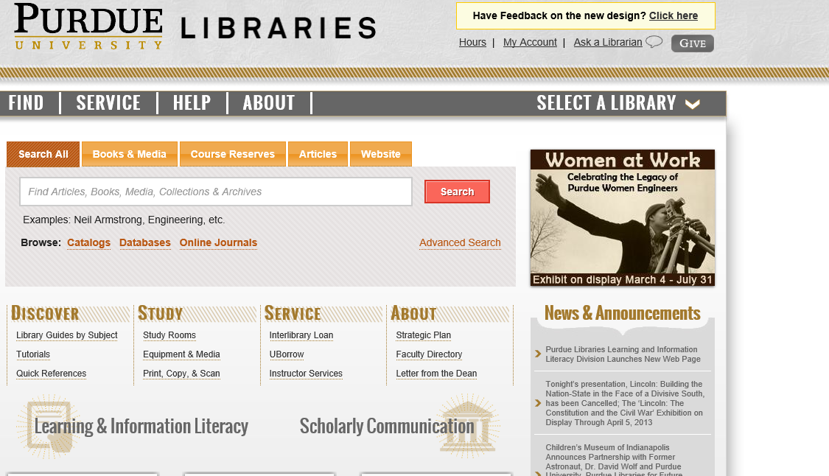
Second
Select Databases

Slide 4
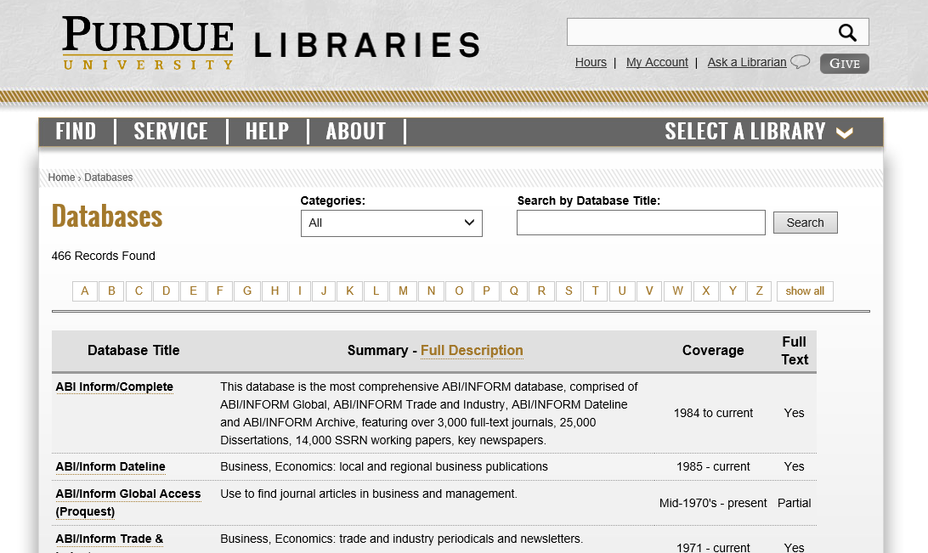
third
For this research paper, we suggest you use the data base comabstracts or psycinfo for your search…enter either option here. Then hit search.

Slide 5
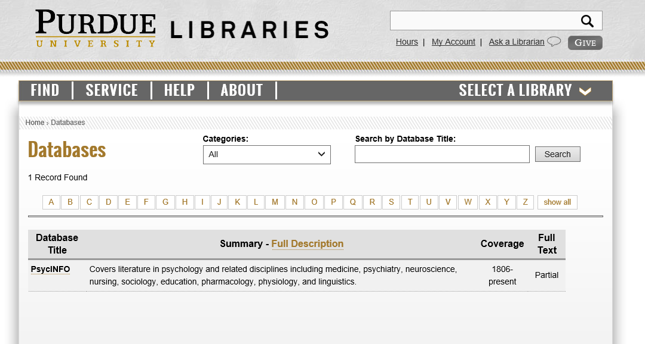
Fourth
Select the database that is listed below.

Slide 6
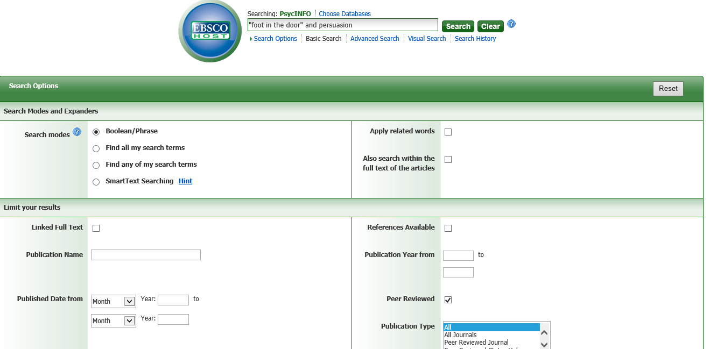
Fifth
Enter your search term in the search box
Check Peer Reviewed to help find scholarly sources

Slide 7
Useful Sources
What is a scholarly journal article?
http://www.angelo.edu/services/library/handouts/peerrev.php
http://www.umuc.edu/library/libhow/scholarlyjournals.cfm
If you have a journal article, but you are not sure if it is scholarly or not, repeat the first two steps listed above, but when you enter a database enter Ulrich’s Periodicals Directory or click here http://www.lib.purdue.edu/find/databases?title=ulrich&titlesearch=titlesearch
Then enter the title or ISSN of the journal article you are looking at and hit search. Find the journal article that you are looking at in the list. If a little icon that looks like a referee jersey appears in the grid to the right of your article, like this:
then your article is peer reviewed/scholarly.

